Slide 1
Title: Amazon Customer Lifetime Value 2.0 Dashboard
Subtitle: Customer Insights, RFM Segmentation & CLV Prediction
Name: Tanmay Sharma
Date: 2025-09-18

Slide 2
Problem Statement :
E-commerce Challenge: "Which customers are long-term valuable and how much future revenue can they generate?"
Business Impact: Helps in customer retention, personalized marketing, and product strategy.

Slide 3
. Dataset Overview
Customers.csv → customer profile
Orders.csv → order transactions
Products.csv → product details
CLV_Summary (derived dataset after RFM + models)
Rows, timeframe (2022–2025), key fields

Slide 4
Methodology:
Data Cleaning & Preparation
RFM Aggregation (Recency, Frequency, Monetary)
BG/NBD Model → predict purchase frequency
Gamma-Gamma Model → predict monetary value
CLV = combine both models → 12-month forecast
Visualization in Power BI

Slide 5
RFM Analysis
Explain R (Recency), F (Frequency), M (Monetary)
Why useful: identifies loyal, at-risk, inactive customers

Slide 6
CLV Modeling
BG/NBD → predicts probability of future purchases
Gamma-Gamma → predicts revenue per transaction
Penalizer Coef explanation (regularization to avoid overfitting)
Output: Customer-level CLV for 12 months

Slide 7
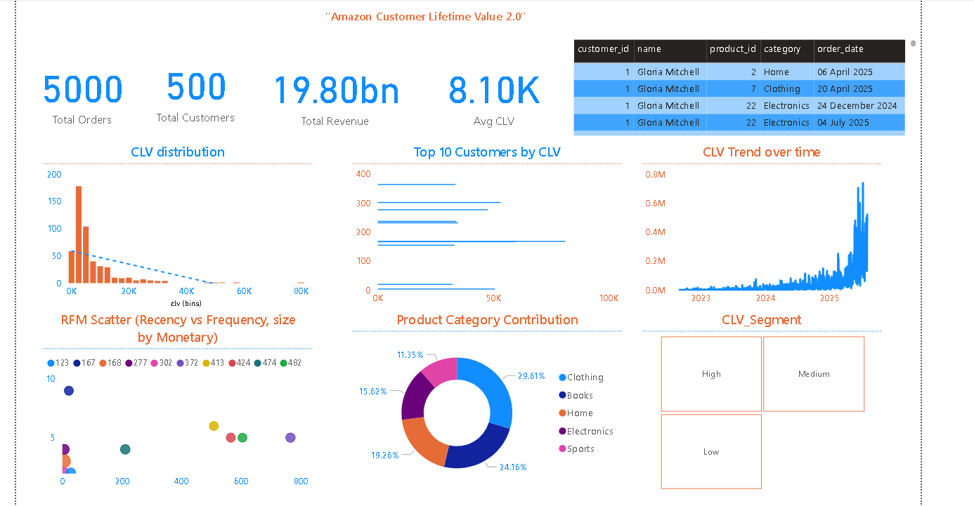
Dashboard – Overview Page
KPIs:
Total Customers
Avg CLV
Total Orders
CLV distribution chart
Top 10 customers by CLV

Slide 8
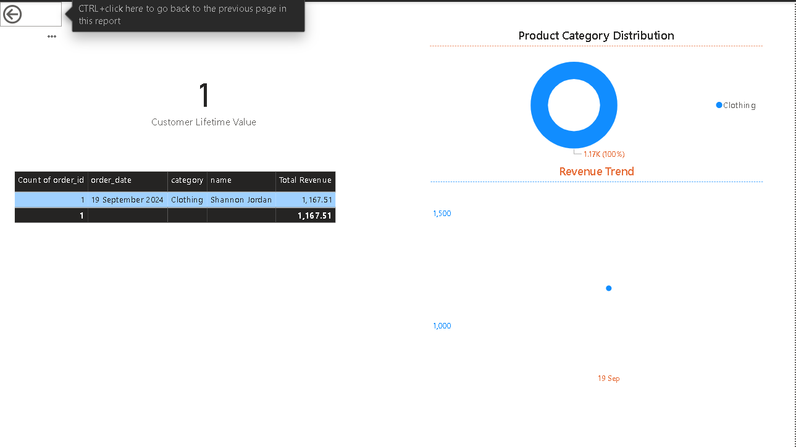
Customer Details Page
Revenue trend of customer
Past purchase history (categories bought, total spend)
Predicted CLV

Slide 9
Key Insights:
20% customers contribute ~80% of revenue → classic Pareto Principle (also called 80/20 rule: a small % of inputs drive the majority of outputs).
High CLV customers mostly buy Electronics (example: laptops, phones).
Revenue has been growing rapidly after the 2023 spike, indicating strong customer demand.
Some customers show high frequency but low monetary value → they purchase often but spend less → opportunity for upselling / cross-selling.

Slide 10
Business Recommendations
Retain high CLV customers with loyalty programs
Reactivate at-risk customers with targeted discounts
Push high-value categories more (e.g., Clothing, Electronics)
Personalize campaigns using CLV segmentation

Slide 11
Thank You/Let’s Connect
LinkedIn: https://www.linkedin.com/in/tanmay-sharma-800599373/
Git hub: https://github.com/Tanu272004/Amazon-CLV-2.0

